Slide 1
Gantt Chart

Slide 2
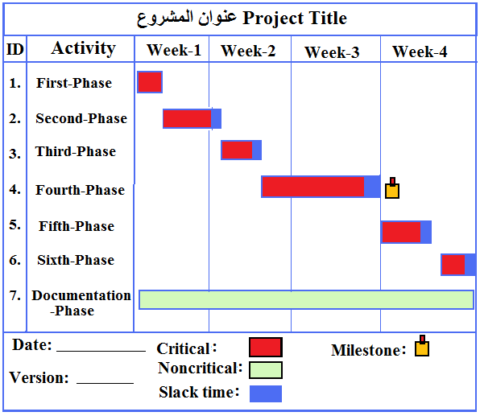
Gantt Chart: A graphical representation of a project that shows each phase as a horizontal bar whose length is proportional to its time for completion. Different shades, shapes or colors can be used to highlight different activities.

Slide 3
Important Definition
Slack Time: Amount of Time That an Activity Can Be Delayed Without Delaying The Project.
Duration: Amount of Time to Complete an Activity/Project.
Overlap: Two of more activities are done fully/partially in parallel
Milestone: used to indicate important dates on the project plan, often key events or goals.
Critical Task: if a change to its start date or duration affects the end date of the project

Slide 4
PERT
Program Evaluation Review Technique (PERT): is a technique that uses optimistic (o), pessimistic (p) and realistic (r) time estimates to calculate the expected time (ET) for a particular task.

Slide 5
Gantt Chart Diagram for Pine Valley Furniture
Steps
  1. Identify each activity
    Requirements collection
    Screen design
    Report design
    Database construction
    User documentation creation
    Software programming
    Installation and testing
3.<number>

Slide 6
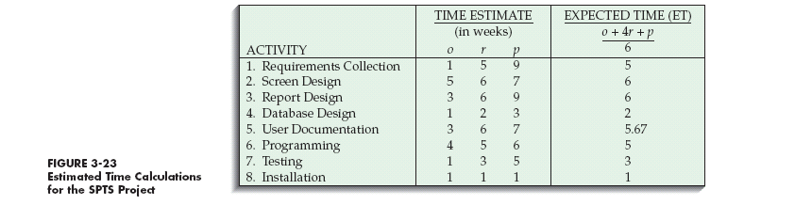
Gantt Chart for Pine Valley Furniture (continued)
  2. Determine time estimates and expected completion times for each activity
3.<number>

Slide 7
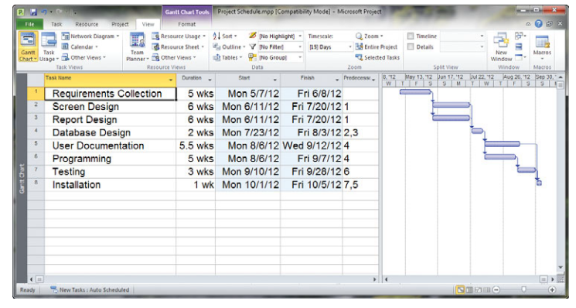
Gantt Chart for Pine Valley Furniture (continued)
3. Create the Gantt Chart

Slide 8
Homework
Use Gantt-chart to prepare project-plan for your project to be completed by the end of the current semester.

